Slide 1
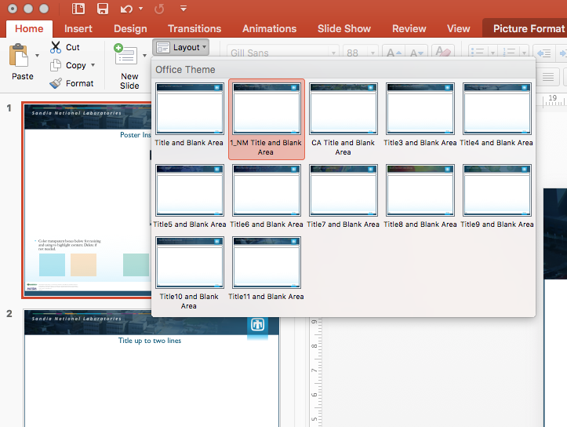
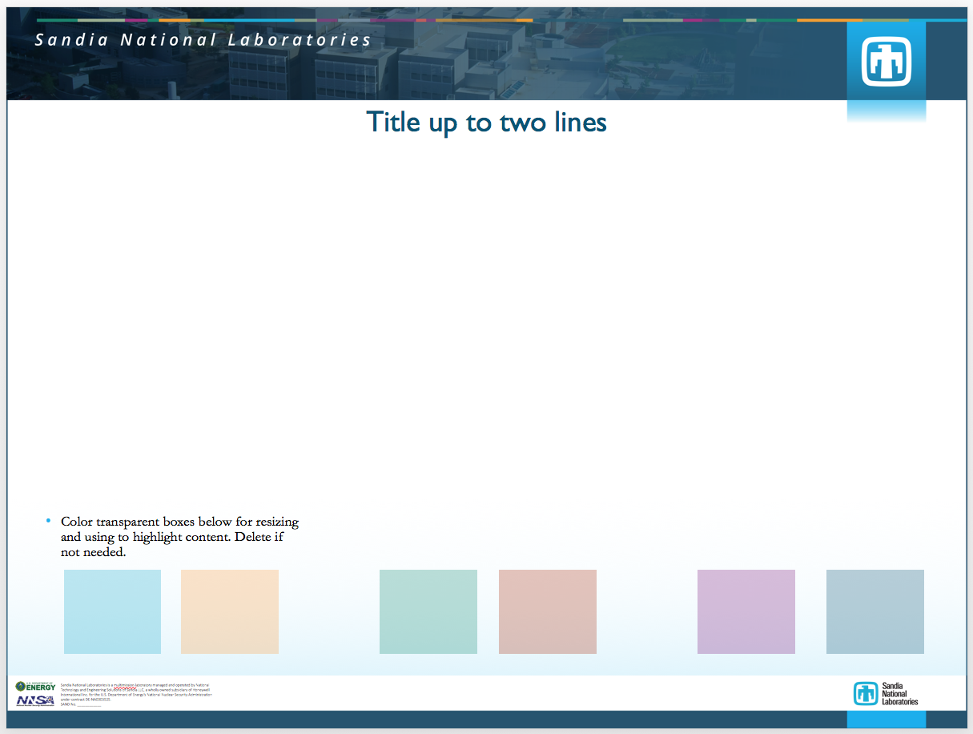
Title up to two lines
Title font: Gill Sans MT
Choose from different headers by selecting the “Layout” option in the “Home” tab
Add Sand Number to the funding statement within the Master Title slide
Additional program/partner logos can be added here
Body text/ support font: Garamond MT
Color transparent boxes below are for resizing and using to highlight content. Delete if not needed.

Slide 2


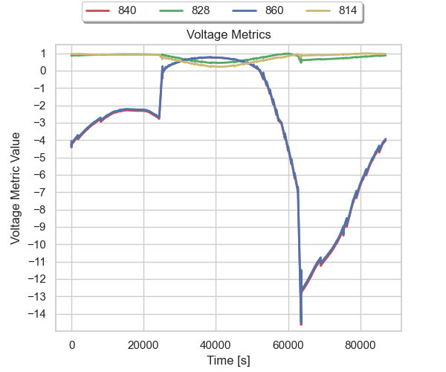
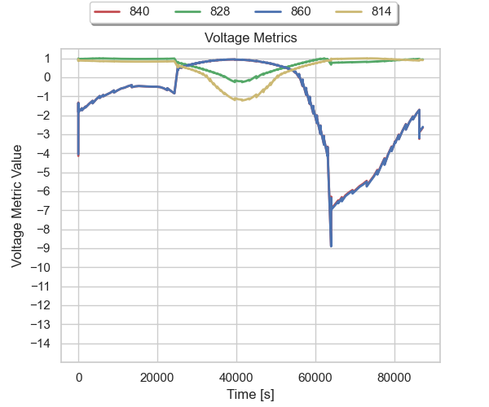
Storage Sizing and Placement in Distribution Grids Will Vining, Ujjwol Tamrakar, John Eddy
Identify optimal sizing and placement of Energy Storage assets on a distribution grid, incorporating considerations of:
Grid physics
Grid reliability
Disruptions caused by extreme events
Metrics are captured and aggregated across the grid to quantify the impact of each storage configuration and allow comparison of different configurations.
Metrics are normalize so that different quantities of interest can be compared directly. For example, voltage levels across the grid can be “traded-off” against line loading, energy service, or any other quantity of interest.
Energy Management System
Storage devices may be placed at bus 814 and bus 840 in this example using the IEEE 34 bus test feeder
Reliability Simulation
Grid Simulation
OpenDSS
Storage Controller
Storage Controller
Storage Controller
Threat model
Load Simulation
Metrics for voltage quality at 4 busses in the feeder above. The metric values become increasingly negative as the limits on voltage are exceeded.
The configuration shown on the right exhibits better performance.
A HELICS-based co-simulation couples:
OpenDSS grid simulation
Grid reliability simulation
Energy management system simulation
Storage controller simulations
The simulation will be distributed as an open source component of Sandia’s QuESt tool.
Storage Device Configuration Options
Storage Device Configuration Options
Storage Device Configuration Options
OpenDSS grid model
Storage Device Configuration Options
Storage at bus 814 only
Storage at bus 814 & 840
Enumerate grid configurations
Simulate each grid configuration
Future work
Simulate building energy demand accounting for environmental and grid conditions.
Simulate threats to the grid such as extreme weather
Include different energy storage controls as part of the optimization parameters
Report optimal configuration and tradeoffs
Aggregate metrics

